Slide 1
EA/NGO & Stakeholders Drought Update
Rob Bakewell
East Anglia Area Drought Project Manager
11 November 2022

Slide 2
EA Information
Water Situation Reports can be found at:
https://www.gov.uk/government/collections/water-situation-reports-for-england
East Anglia Monthly reports can be found at:
https://www.gov.uk/government/publications/water-situation-local-area-reports
24-hour Incident Hotline: 0800 80 70 60

Slide 3
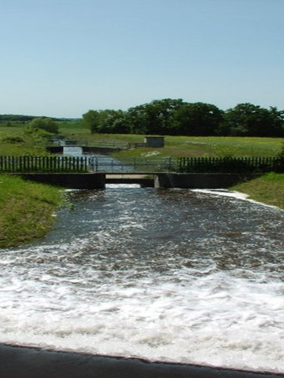
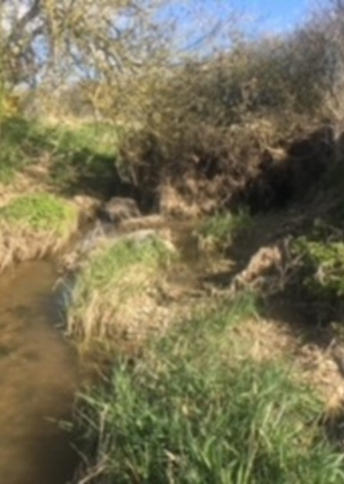
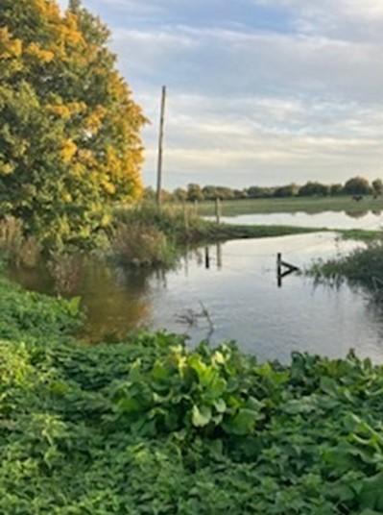
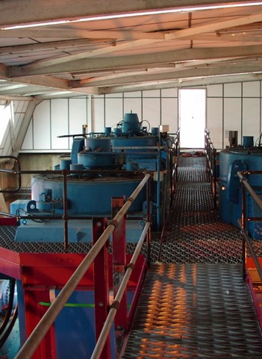
East Anglia East
Drought Prospects for 2023 ( looking back to look forward)
EOETS river Stour 160Ml/day
River Pant July 2022
River Pant November 2022
Kennet pumping station (EOETS)

Slide 4
Progression of drought 2022 – Normal to Worst Fluvial drought for 25 years.
March 2022 groundwater levels unusually consistent across EAN – Normal. No bias to indicate higher risk of drought
March Soil Moisture deficits - Normal
Groundwater declined rapidly in early summer but remained outside of the range typically associated with drought

Slide 5
Progression of drought 2022 – Normal to Worst Fluvial drought for 25 years.
March 2022 River flows consistent across EAN – Normal for late winter . No bias to indicate higher risk of drought.
June 2022 river flows decline rapidly to drought indicator flows ( 1 in 20years). Norfolk and South Essex less at risk
August heatwave - interflow dominated rivers recording lowest monthly flow on record North Suffolk and South Norfolk
Groundwater remains normal or below . So what’s driving recession ? Are forecasts relevant ?

Slide 6
Comparison of Groundwater levels and River flows March –October 2022 North(Norfolk to South(Essex) overview
Groundwater Levels 2022
River Flows 2022

Slide 7
Why the extreme response and how should we view forecasts?
The importance of Spring and summer rainfall. (normal rainfall patterns into April and May can slow the recession of processes we term interflow, field drainage etc. They can also balance the rate of decline in aquifer storage. Groundwater recession is a balance of recharge ‘v’ discharge to and from the aquifer A declining aquifer does not necessarily equal no recharge. The rainfall profile from March 2022 resulted in an almost immediate cessation in recharge rather than a normal shift in balance during the spring .
The role of river valley storage ( and other short lived seasonal stores) ( Bankside storage and the water stored seasonally in shallow aquifers adjacent to riparian zones can delay recession in the spring particularly with a few late season higher low events. The rainfall pattern in 2022 with a dramatic reduction in early march precipitated a very early decline in these stores.
Abstraction demands – (groundwater) The impacts of high groundwater abstraction rates can be experienced seasonally particularly where the aquifer is unconfined. Record high demands for PWS in 2022 would have contributed to lower flow rates. Although it is noted groundwater levels were not exceptionally low.
Abstraction demands – spray irrigation direct from river. The worst affected rivers from South Norfolk to mid Essex experience a high demand direct from river for irrigation and have a decreasing baseflow to sustain flow during peak demand . The impact of concentrated demand during the heatwave was considered exceptional. Abstraction returns should confirm.
Riparian Demands The role of riparian demands for water should not be underestimated. Low lying catchments with broad floodplains can exceed the demand for irrigation (where evapotranspiration can occur at potential rates). This years Et was exceptional with some gauges showing clear rebound as temperatures cooled
These hydrological variables are all very significant in determining the timing and extent of flow recession rates. The timing of rainfall deficits, demands and high temperatures in 2022 were synchronous and amplified the negative aspects of all these components. This doesn’t often happen, historical drought summers have often been wet enough to mitigate the worst impacts on flow. Not this year !
These hydrological responses are critical to the Spring and early summer recession and are therefore not directly forecastable with long lead in times. 80% , 60% forecasts must therefore be treated cautiously .

Slide 8
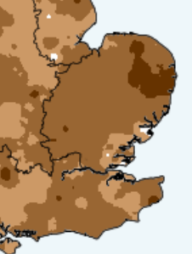
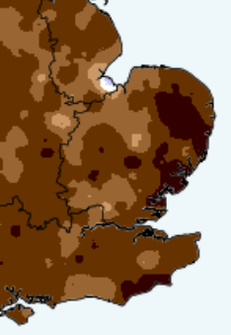
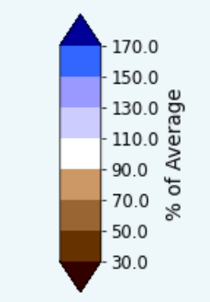
Met Office Seasonal Anomaly Maps
Spring 2022
Summer 2022

Slide 9
EA Rainfall Deficit data August 2022
Standard EA forecasting based on 12 month 60% (Actual Worst case) and 80% (reasonable worst case ).
2022 previous 12month rain c.73%
Meteorological summer rainfall (June to August as low as 24% at Benhall following a spring below 50 %
These figures are extreme (greater than 1 in 80 years) but demonstrate the indeterminacy and risk of relying on standard forecasting scenarios.
Current indicators of bias towards a higher risk of drought next year are current groundwater levels and most importantly Soil Moisture deficit

Slide 10
Latest Soil Moisture deficits 10/11/2022
SMD is the most significant indicator for a potential recharge deficit.
Until mid October SMD remained above normal and close to record high.
Above average rainfall since mid October has resulted in a rapid decline to nearer normal conditions – slightly below in Essex and Slightly above in Norfolk.
These spatial differences are relevant to understanding current risk of drought continuing in 2023. Norfolk groundwater dominated rivers remain a month of average rainfall from sustained recharge. Essex rivers are now responding to field drainage and aquifers expected to recharge earlier. The implication Norfolk rivers could prove less resilient than 2022.

Slide 11
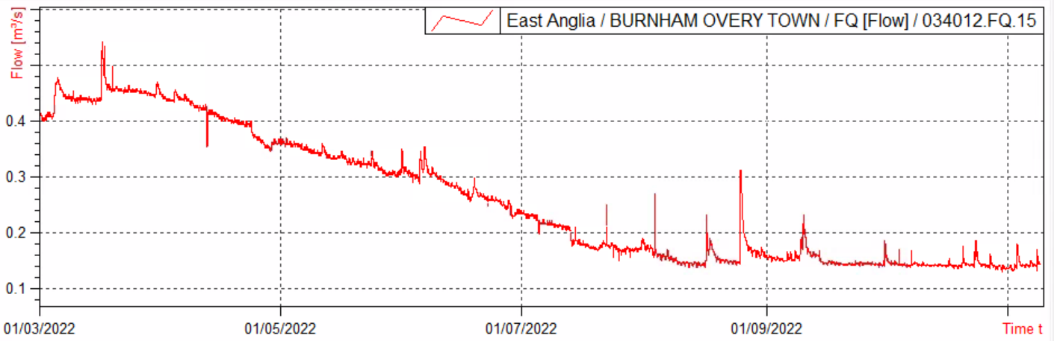
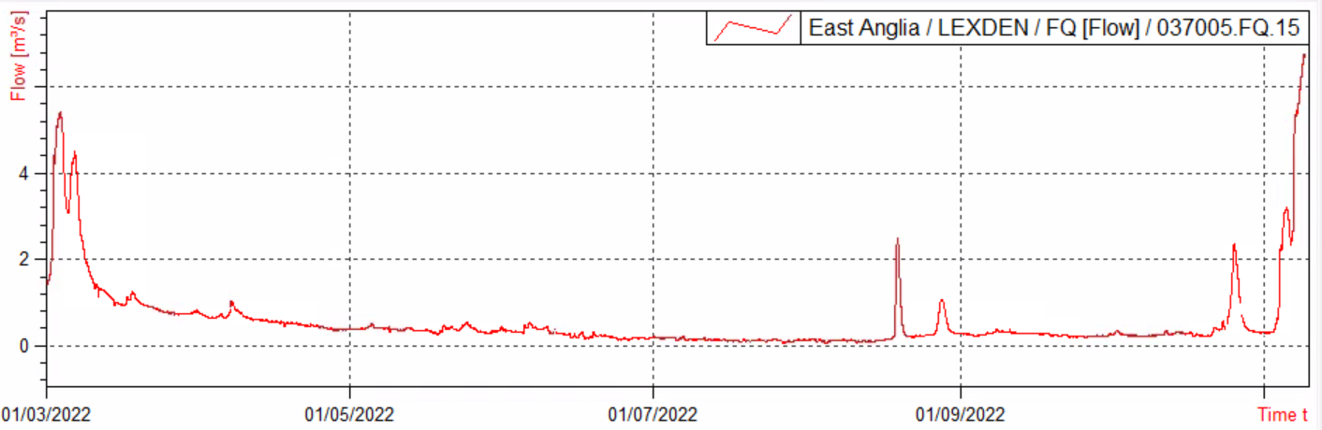
Comparison of recent response to Rainfall –Diminishing risk ?
River Burn North Norfolk – 97% groundwater fed. No run off or baseflow response. Indicative of bias towards higher risk of drought
River Colne In Essex 48% groundwater fed – lower smd now generating field drainage response . Bias toward drought next summer diminishing . Good prospects for winter fill of reservoirs

Slide 12
Summary of prospects for 2023
Reasonable worst case 80%
Groundwater unlikely to fully recover. Below normal or notably low.
Norfolk baseflow dominated rivers are at more risk from a repeat heatwave event. Flows likely to equal or fall slightly below 2022
Current eleveation In risk from 5% unbiased long term average to 15-20% of drought next summer.
S57 possible in line with risks above but only if co-incident with a period of hot dry summer weather.
S57 would probably not exceed 50 % of daily cuts
Winter reservoirs should refill even from current low states .
Actual worst case 60%
Groundwater likely to begin summer notably low or exceptionally low. Suffolk and Essex shallow aquifers more likely to attain ‘below normal’ or ‘notably low’ North East Norfolk likely to be lowest
All catchments less resilient than 2022. Summer heatwave likely to create very high risk of environmental incidents.
Current elevation in risk from 5% unbiased long term average to 10% -12% of severe drought next summer .
S57 could be 100% for short periods of extreme heat . High likelihood of 50% cuts at some point in season
Possible lowest historic flows would be recorded
Winter reservoirs should refill , but those in groundwater dominated rivers and currently empty may only partially recover.

Slide 13
East Anglia West
Prospects for winter 2022-23
The hydrological situation at the end of winter does not fully determine the risk of environmental problems and licence restrictions during the following summer.
Indicators of the hydrological situation during autumn and winter
Groundwater level forecasting

Slide 14
Indicators of the hydrological situation during autumn and winter
Rainfall
Soil moisture deficit
Groundwater levels
Reservoir storage levels
River flows (baseflows as an indicator of groundwater levels; total flows as indicators of catchment wetness and determiners of reservoir filling)
Rainfall forecasts

Slide 15
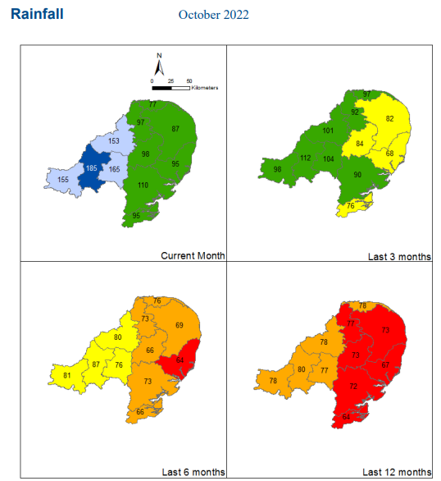
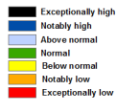


Slide 16
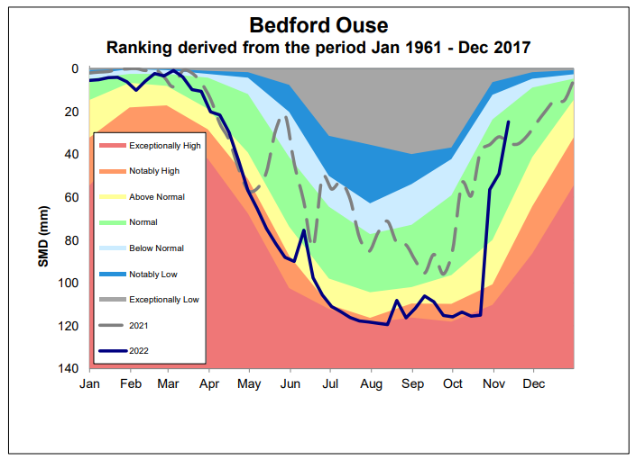
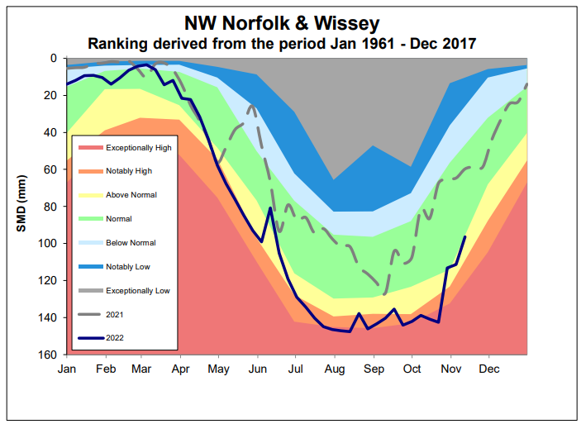
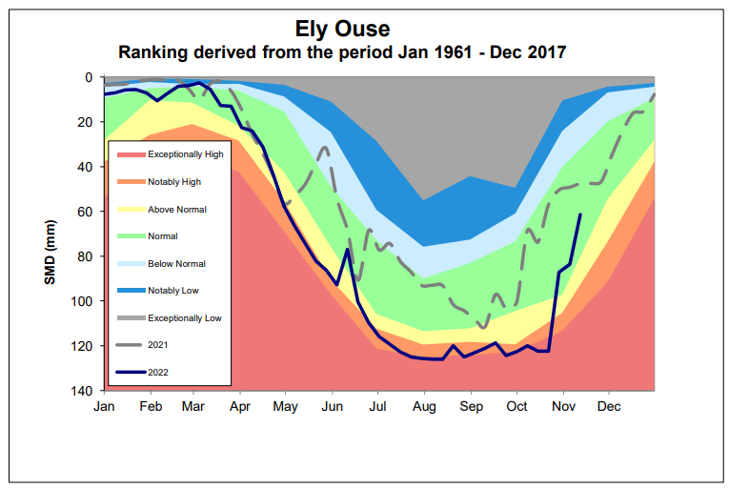
Soil moisture deficits for
East Anglia West
Simulated for 08/11/2022

Slide 17
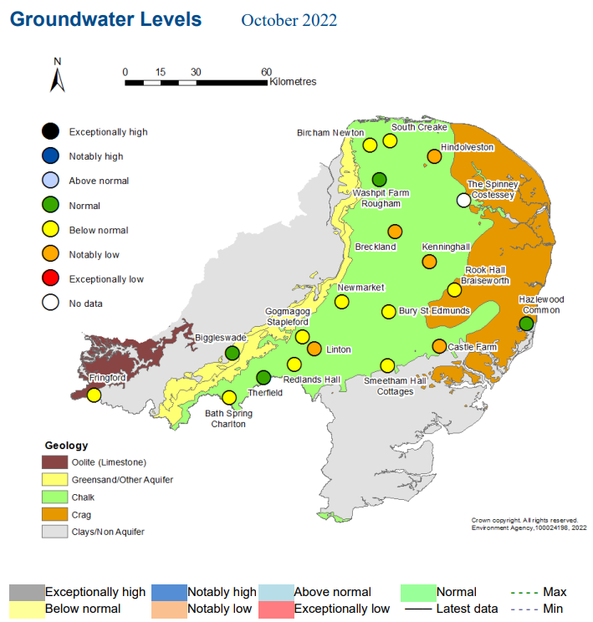
Return periods of categories:
Below Normal: 1-in-4 years to 1-in-8 years
(15% of observed values in this category)
Notably Low: 1-in-8 years to 1-in-20 years
(8% of observed values in this category)
Exceptionally Low: 1-in-more-than-20 years
(5% of observed values in this category)

Slide 18
Groundwater level forecasting – scenario runs

Slide 19
Groundwater level forecasting – ensemble runs

Slide 20
Groundwater level forecasts
8 groundwater models covering the East Anglia Area are run.
Scenarios of 60%, 80%, 100% and 120% are run for each model.
Probability of 60% long-term average rainfall or lower by March 2023 is ~7%.
Probability of 80% long-term average rainfall or lo
Scenario with 60% of long-term-average rainfall every month
By March 2023, most sites are at Notably Low or Exceptionally Low groundwater levels. Those categories cover return periods from 1 in 8 years to 1 in more than 20 years.
Scenario with 80% of long-term-average rainfall every month
By March 2023, most sites are in either Below Normal or Notably Low. Those categories cover return periods of between 1 in 4 years and 1 in 20 years.
Scenario with 100% of long-term-average rainfall every month
By March 2023, most sites are in the Normal or Below Normal range. The return periods for those categories is less than 1 in 8 years.

